Slide 1
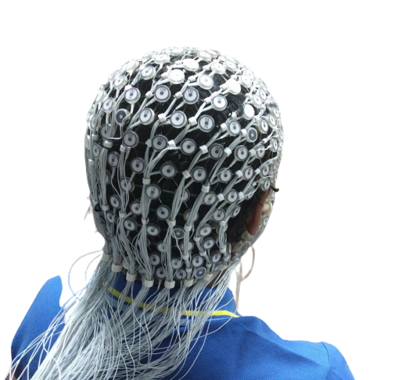
Subject Identification Using an EEG-based Biometric System
Steven Cao
Dr. Nicole Midani
Northwood High School

Slide 2
Abstract
Electroencephalography (EEG) signals present major advantages over other biometrics modalities (i.e. iris, face, fingerprint), such as being resilient to physical injuries, extremely hard to reproduce, and cannot be furtively captured at a distance. However, the field of EEG-based biometrics is new, and there are still many challenges that need to be solved for its real-world application, including improvement of accuracy, stability, and robustness.
The objective of this project is to create a machine learning (ML) pipeline to examine the feasibility of EEG-based subject identification for long periods of time. For better practical use, the ML pipeline we built here focused on the tuning of different modified ML models, including K-Mean, Naïve Bayes, 4-layer neural network, XGBoost, ResNet, Inception and EEGNet. We also enhanced the EEG signals based on their statistical information and showed that data preprocessing is critical in tuning different ML models.
Results show that, compared to XGBoost, the most used model in literature, which had an accuracy of 57.82%, our version of EEGNet model achieved the best result with an accuracy of 86.74%, and Inception ranked the second with an accuracy of 70.18%.

Slide 3
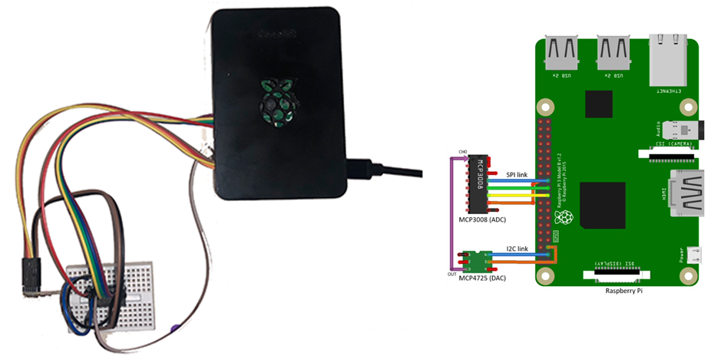
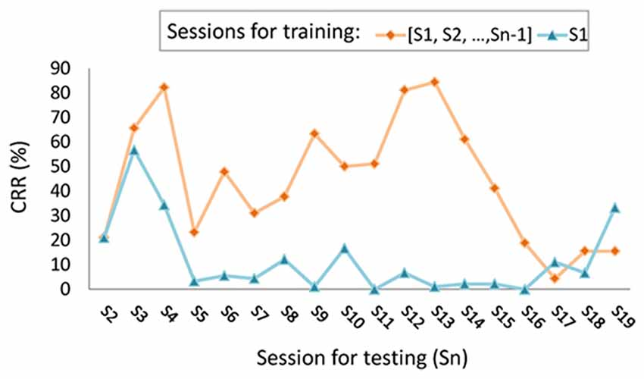
Problem
Current EEG-based biometric systems for subject identification is impractical in real-world scenarios because of its low accuracy in its predictions over long periods of time.
Electroencephalography (EEG)-based biometric system using Raspberry Pi for subject identification (Courtesy to my team member: Mohamed Benomar Msc)
Person recognition using finger-lifting EEG data showed fluctuations in the accuracy (classification recognition rate or CRR) when tested using newly acquired data (Chan, Kuo, Cheng, and Chen, 2018).

Slide 4
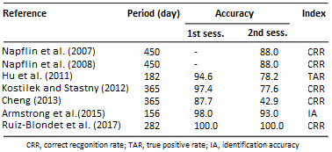
Introduction (Background Research)
Background:
An effective subject identification system must be able to recognize subjects, even when they return days, weeks, or years later. However:
Few studies have examined the stability of their systems over long spans of time. (Chan, Kuo, Cheng, and Chen, 2018).
Some shows that the error rate performance of an identification system could increase within days (Marcel and Millan, 2007; Hu et al., 2011).
Others demonstrate a drop in performance when the training and test sessions of EEG data get further apart (Pozo-Banos, etc., 2014).
Studies of EEG-based subject identification shows a decrease in accuracy over long periods
Criteria:
Design an ML model to examine the feasibility of EEG-based subject identification, for long periods of time, compare traditional ML models with deep learning models, and achieve better performance than the state-of-the-art results from XGBoost with data from multiple sessions

Slide 5
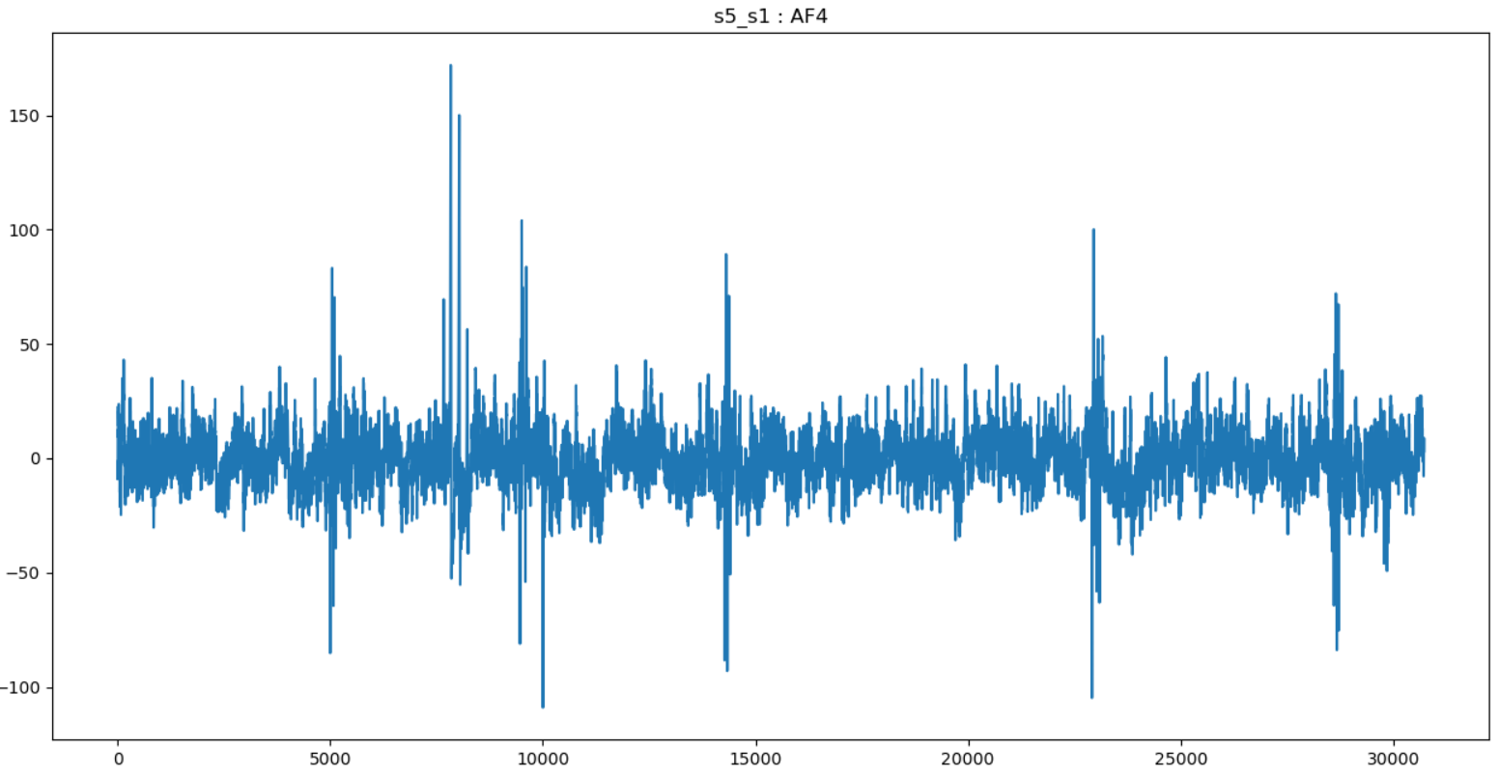
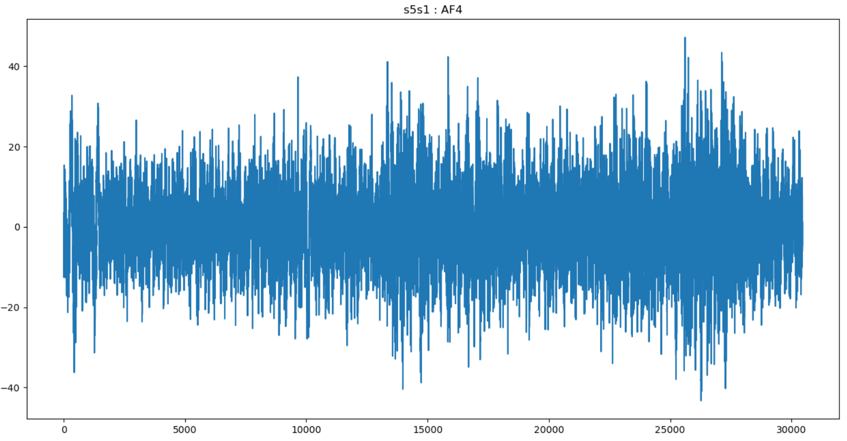
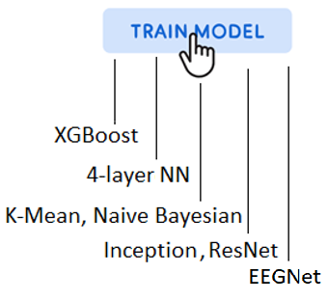
Hypothesis
Loading data
Data-preprocessing
Removal of Artifacts
Raw EEG data
Extraction of SPEC features
Removal of bad subjects
Project Scope:
Assist the Raspberry Pi hardware to implement an ML Pipeline that will load the raw EEG data, then preprocess the EEG data by filtering out the artifacts and noise from the EEG data, and finally modify and train different ML models on the preprocessed EEG data.
Hypothesis:
We hypothesize 1) EEG-based subject identification is feasible over long periods of time; 2) tuning of different ML models should give better performance on subject identification; 3) Data preprocessing of raw EEG data is critical in the tuning of different models.

Slide 6
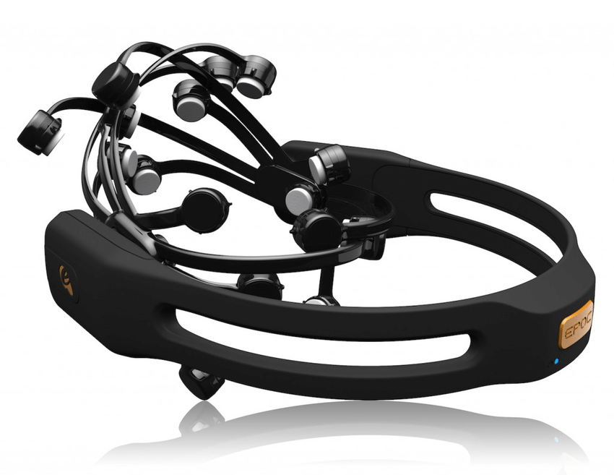
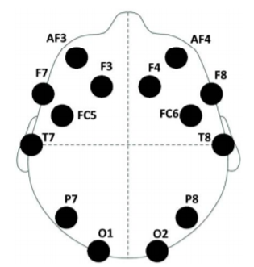
Materials
BED: Biometric EEG Dataset
Uses Emotiv EPOC+ headset for EEG acquisition at a sampling rate of 256 Hz.
21 subjects were recorded, and each subject contains 14 channels:
AF3, F7, F3, FC5, T7, P7, O1, O2, P8, T8, FC6, F4, F8, and AF4.
Emotiv EPOC + headset
locations of 14 channels
Software used
PyCharm IDE
Anaconda: Python 3.8
Python Modules used:
Torch
Pandas
Numpy
Tensorflow
Tensorboard
Keras
Sklearn
Scipy
Seaborn
Pyprep
Mne
XGBoost
Lazy Predict
Librosa

Slide 7
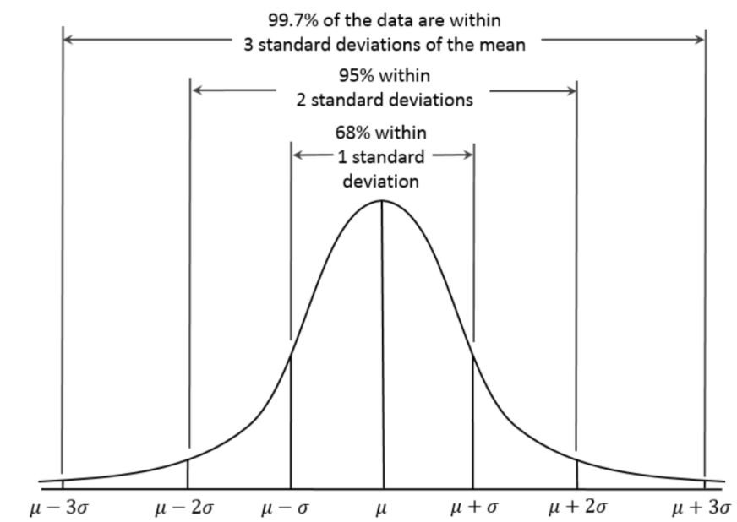
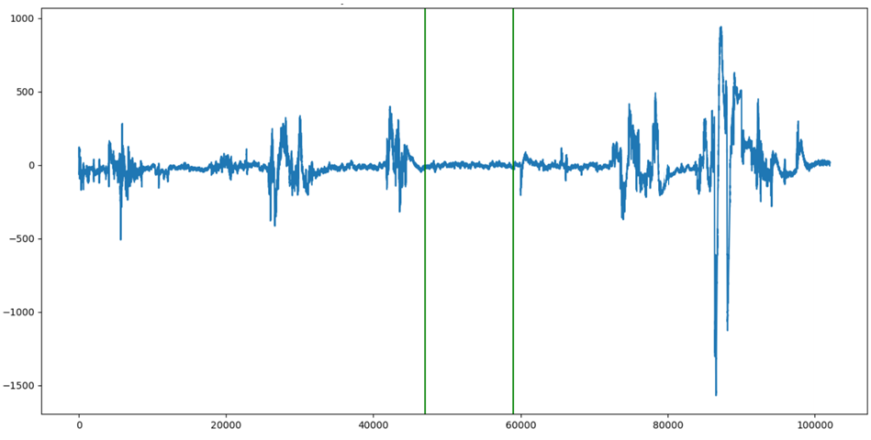
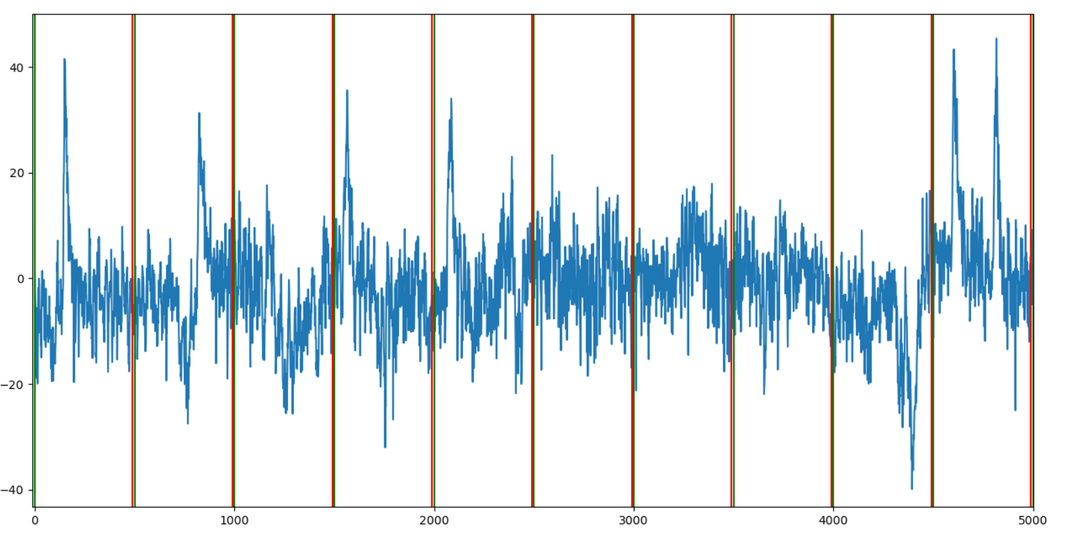
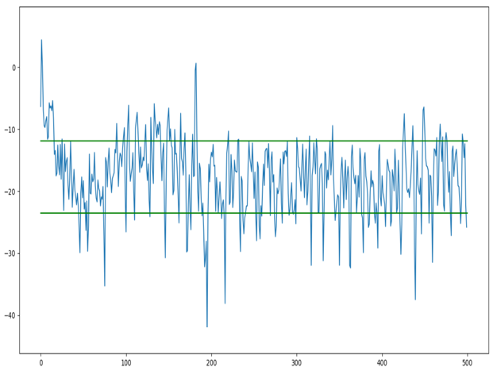
Procedure
Dataset
12 different stimuli from four different types are collected, including:
affective stimuli, cognitive stimuli, visual evoked potentials, and resting-state, Each stimulus contains three chronologically disjointed sessions one week apart.
First two sessions were used for training, and the third session for testing.
Central Limit Theorem (CLT)- based data enhancement
good segment (green lines)
Splitting into epochs
STD of epochs
Central limit theorem
Good segments of EEG signals are selected and split into epochs, statistical information based on STD (standard deviation) of epochs are computed, and a threshold is determined based on central limit theorem to clean the data, including removing the bad subject.
Epoch-based Least-Squares Regression (EBLSR)
Calculate the least-squares regression line as the trend for each epoch.
Remove the trend for each epoch.

Slide 8
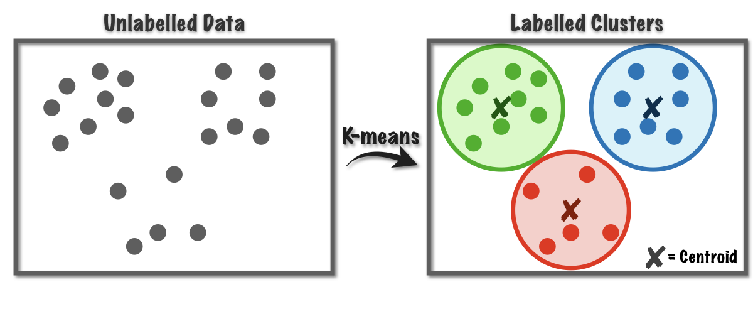
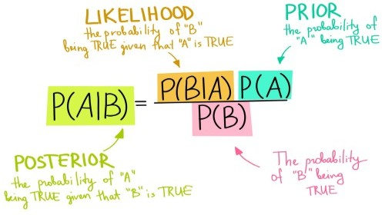
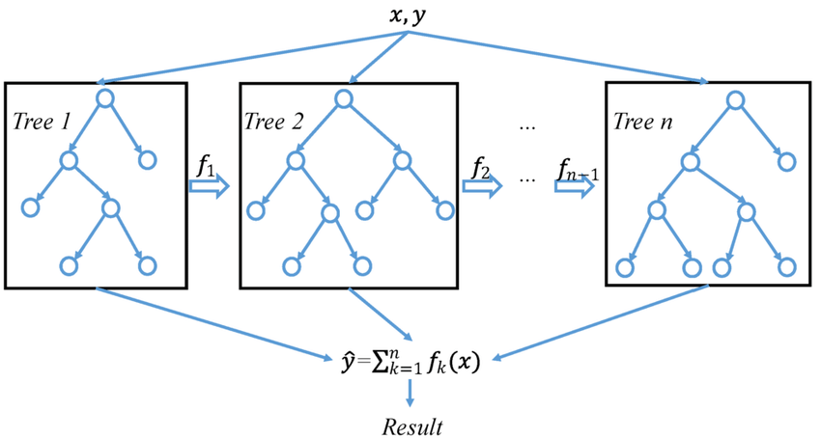
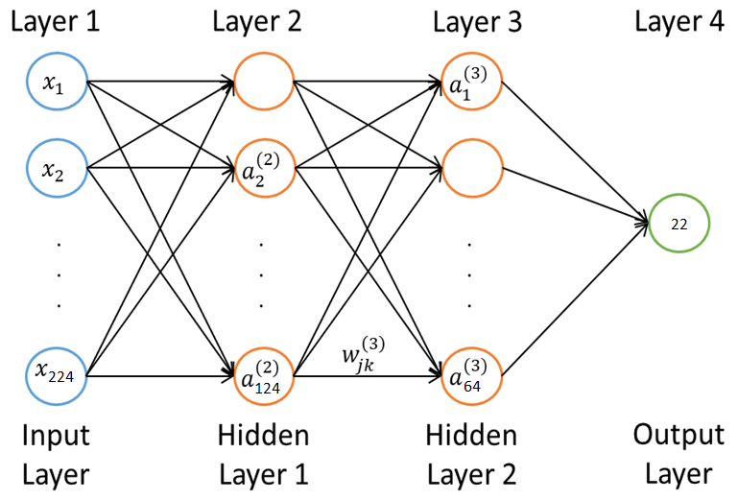
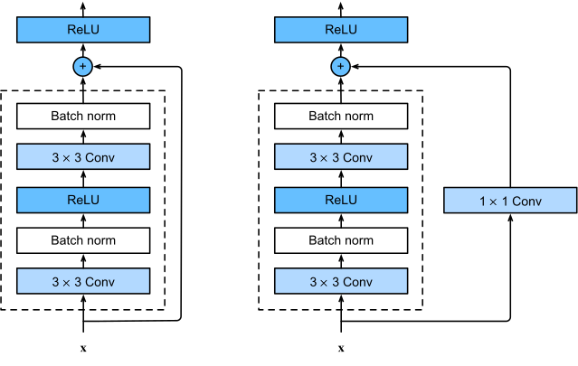
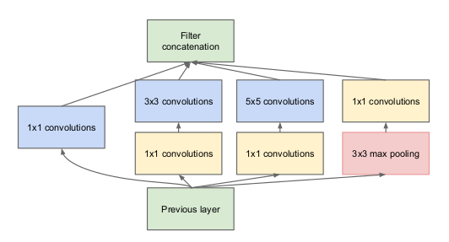
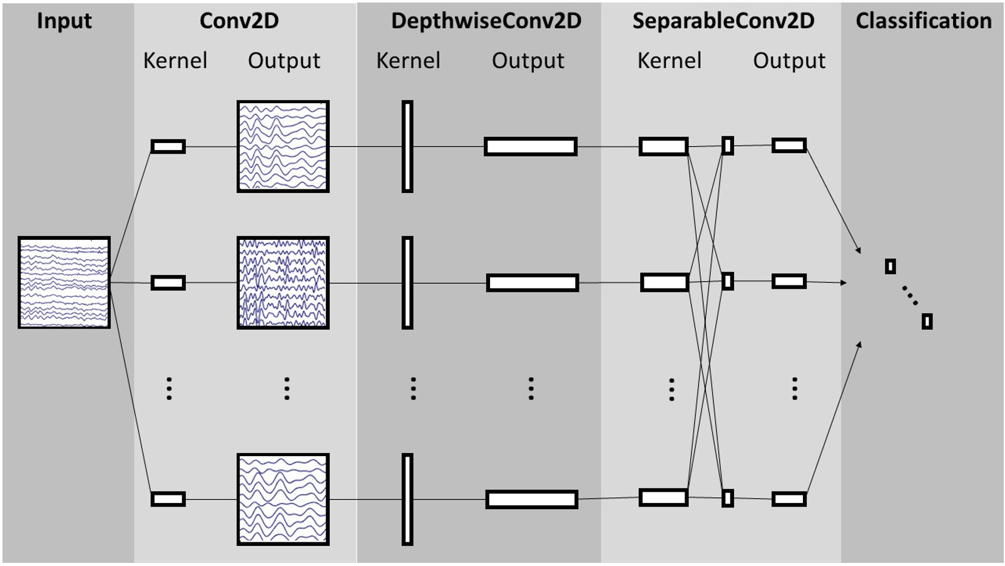
Procedure (Continued)
Seven different ML models that were modified, tuned and tested:
K-Mean
(Lloyd et al., 1957)
Naïve Bayes
(Bayes, 1763)
XGBoost
(Chen, 2016)
4-layer neural network
(McCulloch et al., 1943)
ResNet
(Wang et al., 2016)
Inception
(Fawaz et al., 2019)
EEGNet
(Lawhern et al., 2016)
Testing method:
We used the confusion matrix to evaluate the accuracy, precision, recall, and f1 score of each model.
We also run case-by-case investigation to examine the model performance.

Slide 9
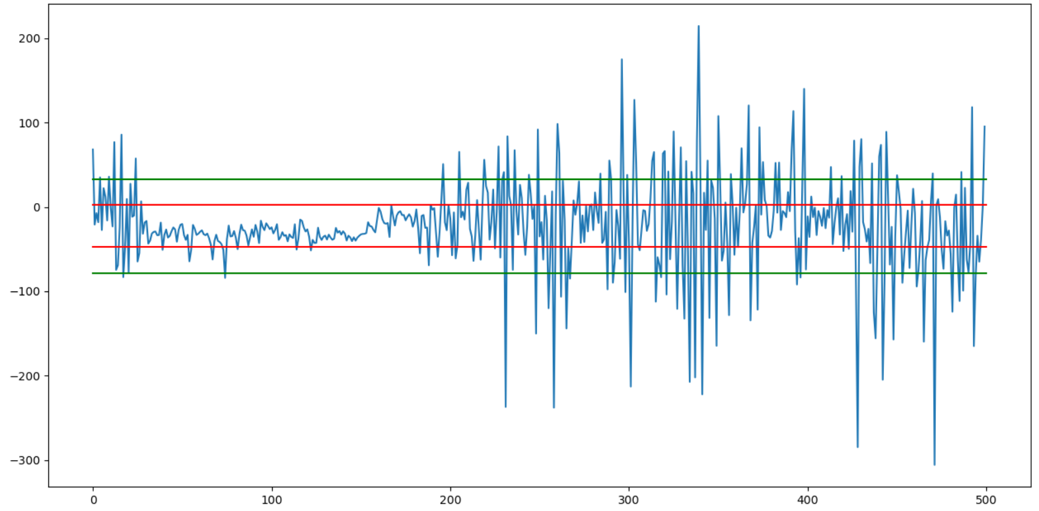
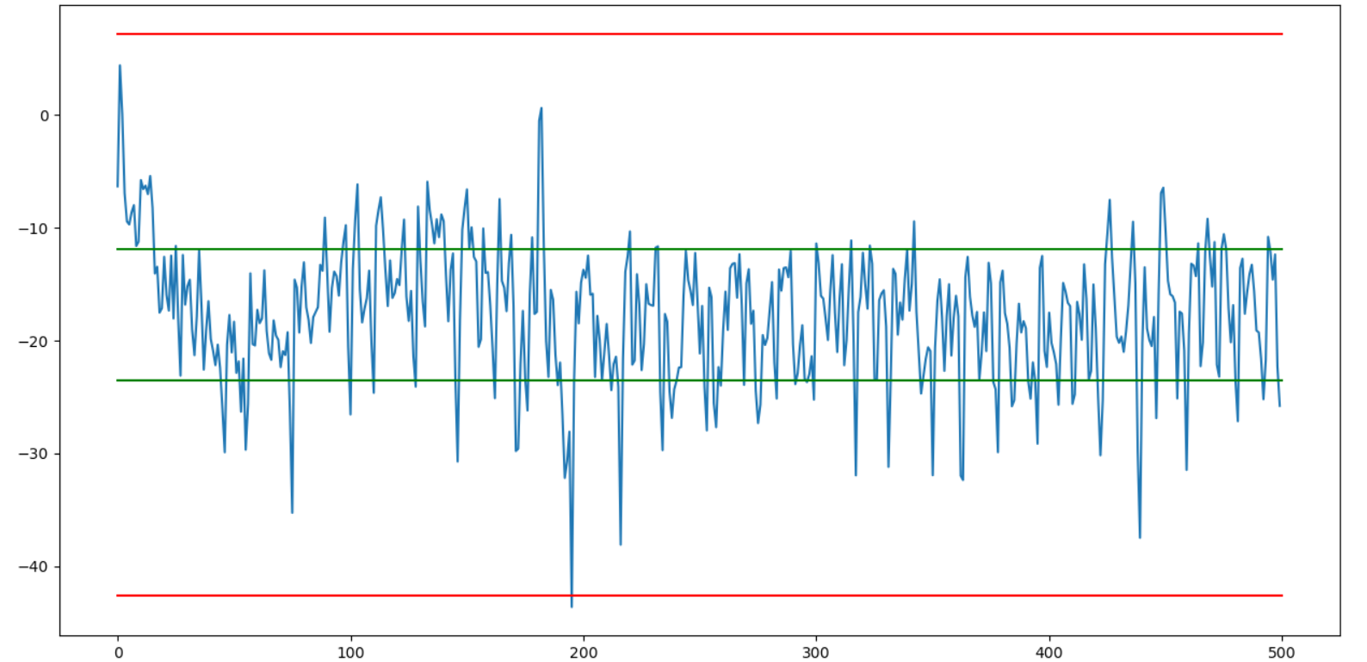
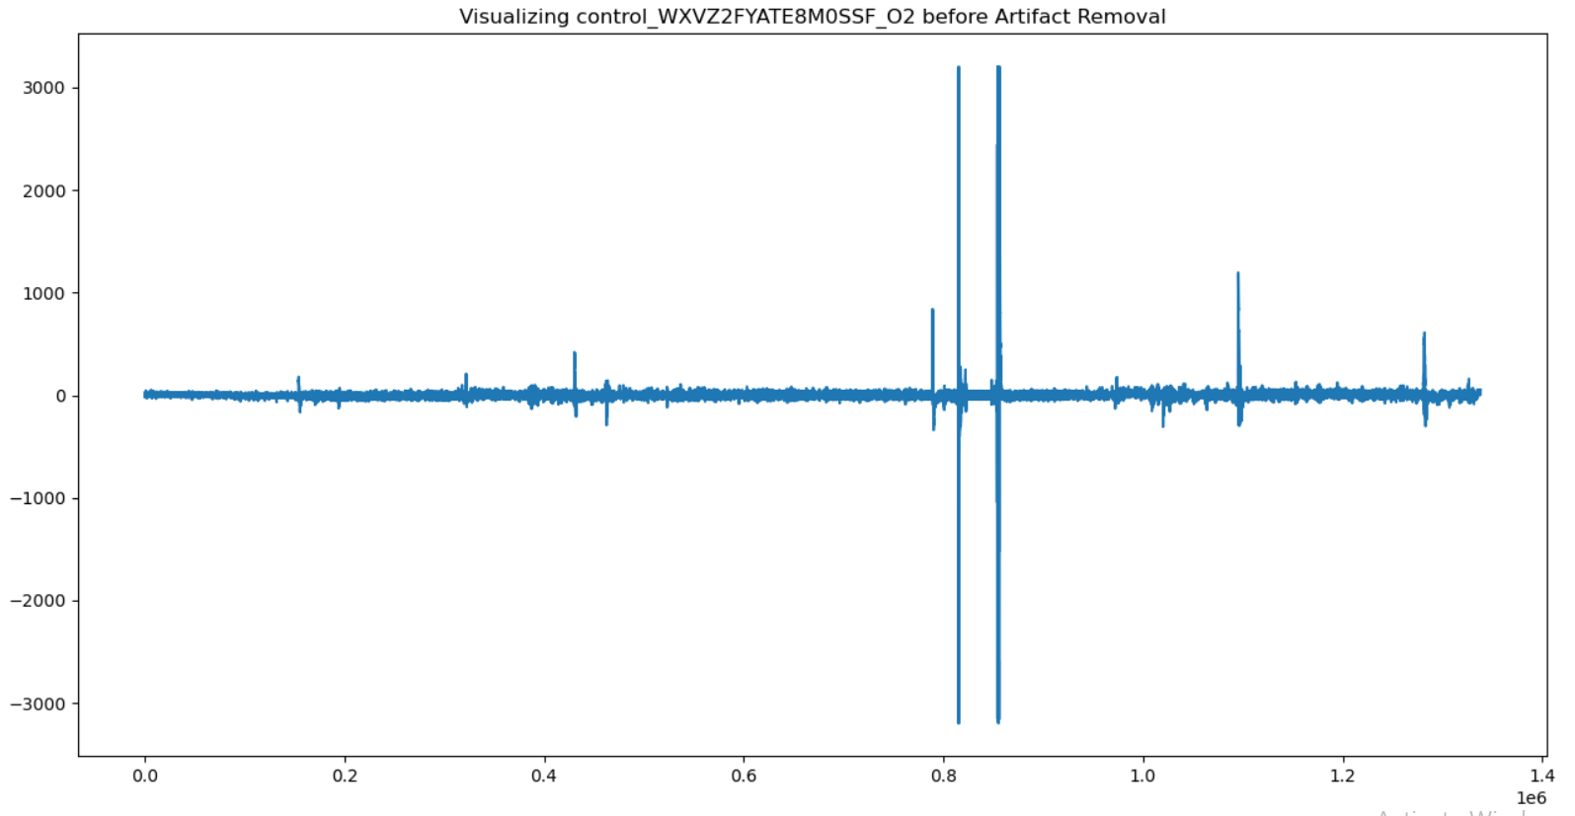
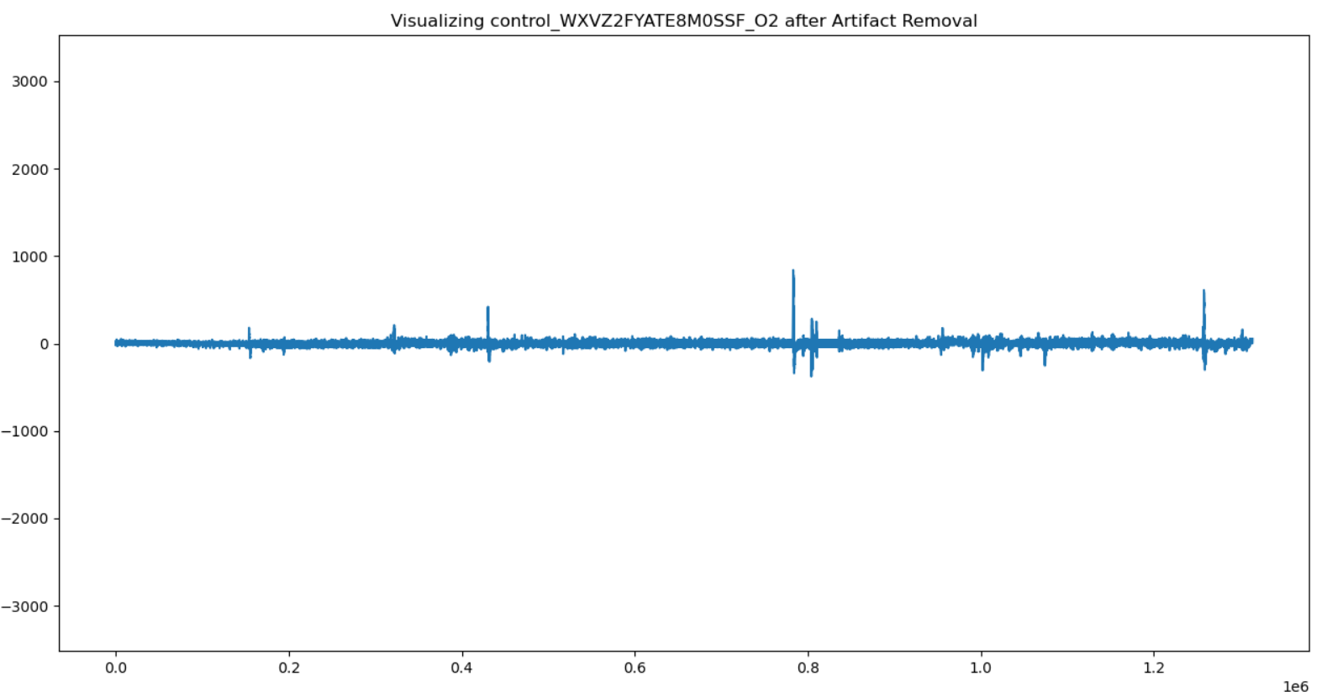
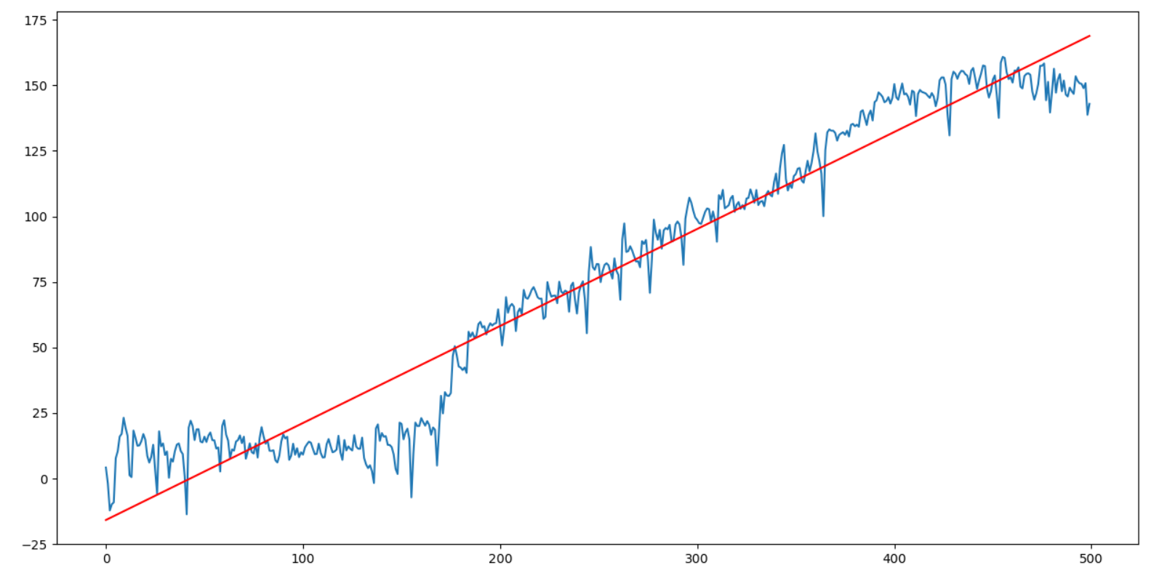
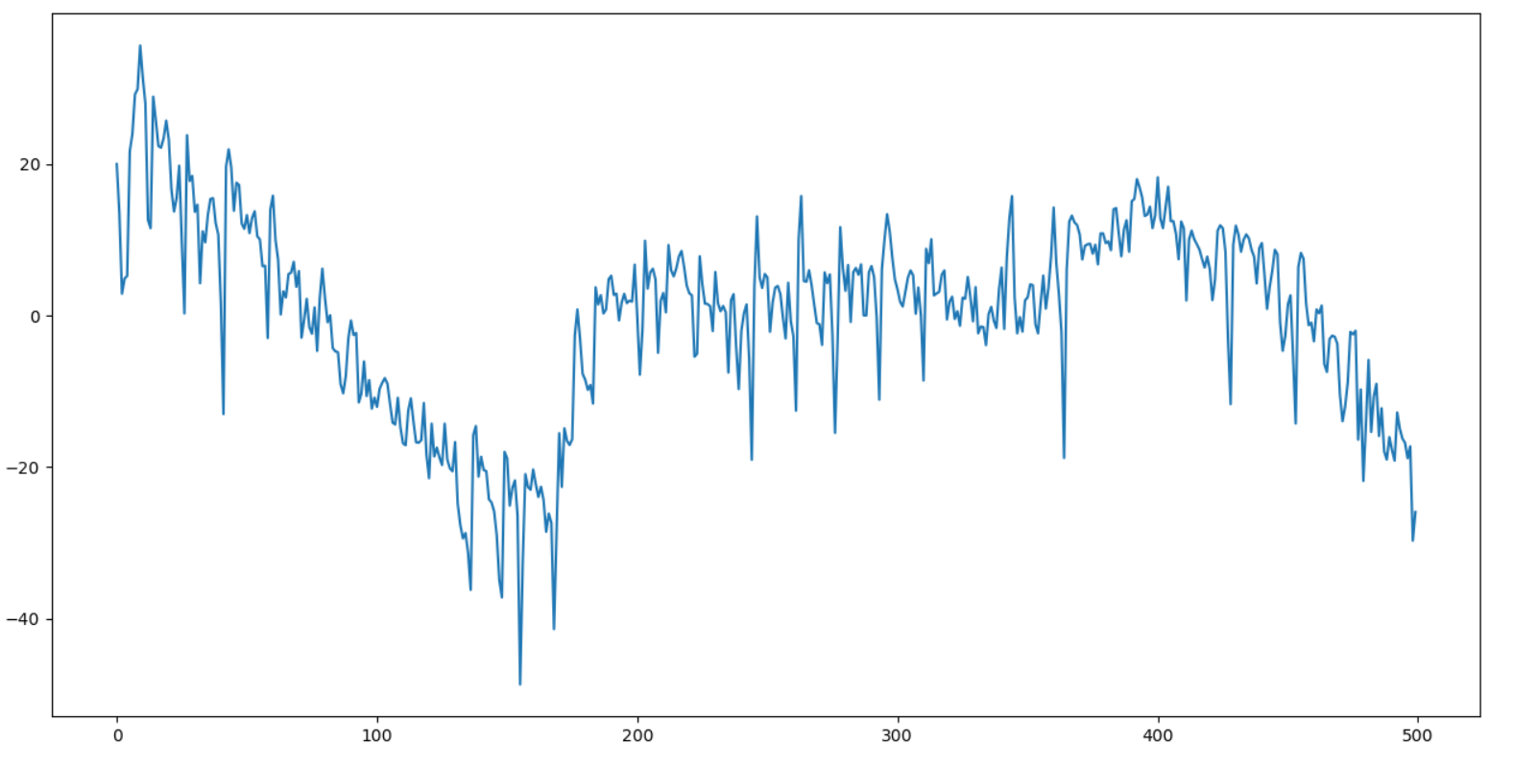
Results
Central Limit Theorem (CLT)-based data enhancement
Bad epoch
Good epoch
Raw subject signal
After being cleaned
Red lines are the thresholds determined based on central limit theorem. Left shows a bad epoch (its std lines shown in green exceed the threshold), and the right instead shows a good epoch (its std lines are within the threshold)
Epoch-based Least-Squares Regression
Raw epoch signal and its linear trend
Corrected epoch signals after trend removal
This epoch that was initially falsely determined as bad (left) was re-determined as good after the trend was properly removed (right).

Slide 10
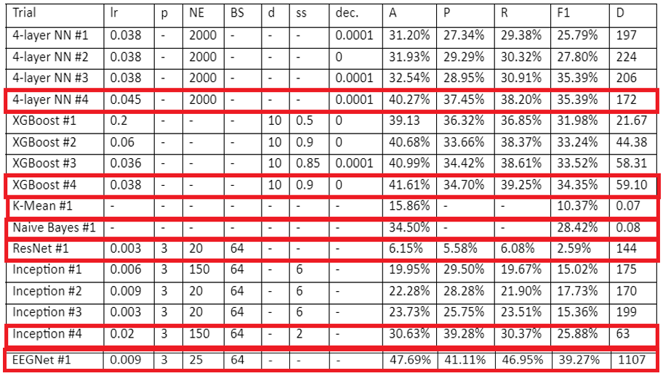
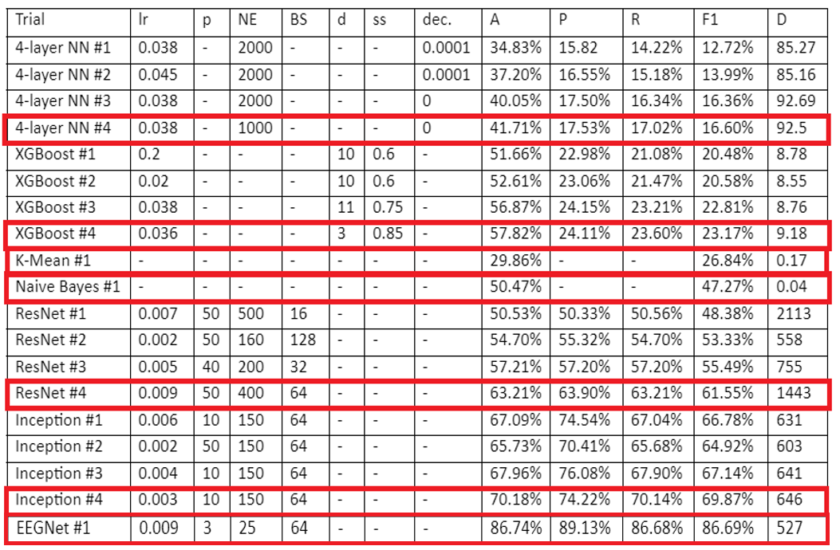
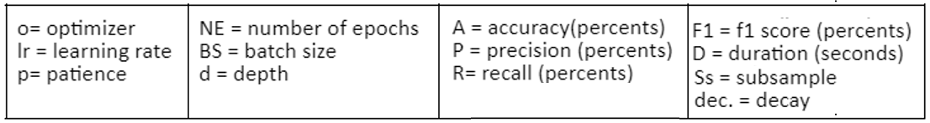
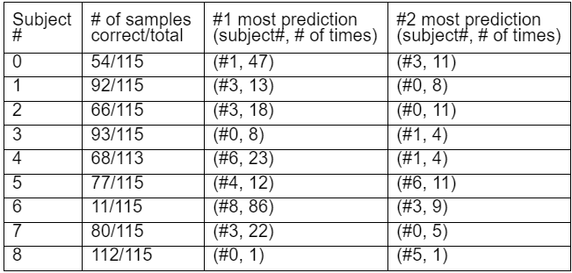
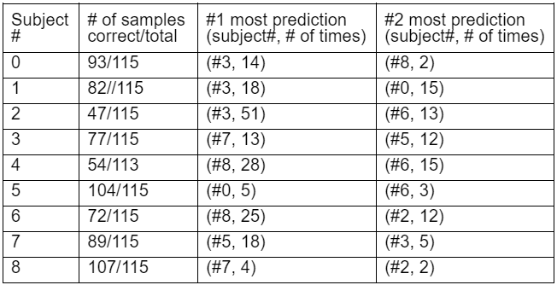
Results (Contin.)
Tuning of different ML models on EEG data
Based on raw EEG data
After data enhancement
Best run in tuning the models is shown in red box for each model. (only shows a maximum of four trials per model for demonstration)
Case by case investigation of model performance
Best trial
of ResNet
Best trial
of Inception

Slide 11
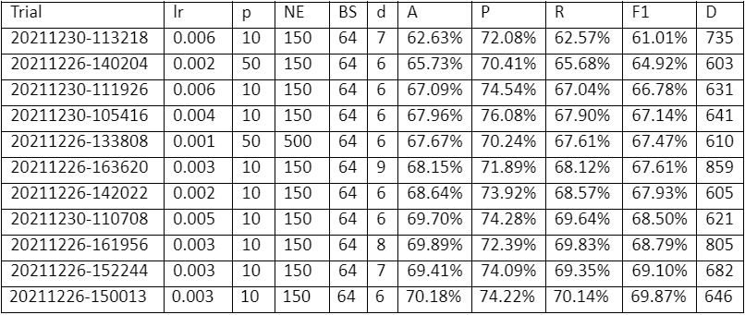
Discussion
Deep learning models outperforms traditional ML models
XGBoost is used as a baseline model for comparison. Currently, XGBoost is very successful across many tasks on EEG-based modeling (Ravid Shwartz-Ziv, Amitai Armon, 2021).
However, we found that a proper tuning of deep learning models can outperform XGBoost. For example, compared to the accuracy of 57.82% from XGBoost, the deep learning models can reach an accuracy of 86.74% from EEGNet, an accuracy of 70.18% from Inception and an accuracy of 63.21% from ResNet.
One main reason is that XGBoost was using manually-designed extracted spec features; however, deep learning models, like EEGNet, Inception and ResNet, can take advantage of the automatic feature representation capability in its internal layer structures and reduce bias in feature engineering to reach better performance.
Tuning of deep learning models is important
Different trials in training a deep learning model can give different accuracy. It is important to tune the model using different hyper-parameters to find the optimal solution. The figure (right) shows that the performance of an Inception model can vary from 62.63% to 70.18% for its accuracy in different trials.
Different trials in tuning Inception model

Slide 12
Discussion (Contin.)
Data enhancement is important
We cleaned our data using Central Limit Theorem-based data enhancement and Epoch-based Least-Squares Regression (EBLSR). It turns out this data preprocessing stage is critical for a good performance from deep learning models.
We compared the accuracy of the best trial for different models before and after data enhancement, and the results are shown below:
before data enhancement
K-Mean: 15.86%
Naïve Bayes: 34.50%
XGBoost: 41.61%
4-layer NN: 40.27%
ResNet: 6.15%
Inception: 30.63%
EEGNet: 47.69%
It shows that deep learning models might not reach their optimal performance. For example, EEGNet can only give an accuracy of 47.69% without data enhancement, which is quite low, although a little better than the accuracy of 41.61% from XGBoost.
after data enhancement
K-Mean: 29.86%
Naïve Bayes: 50.47%
XGBoost: 57.82%
4-layer NN: 41.71%
ResNet: 63.21%
Inception: 70.18%
EEGNet: 86.74%
EEG-based subject identification is feasible
An EEGNet model can give an accuracy of 86.74%, which demonstrates a big promising future for EEG-based subject identification over long periods of time.

Slide 13
Conclusion
We examined EEG-based subject identification using a consumer-grade EEG acquisition device (Emotiv EPOC+ headset) and came out with a good deep learning EEGNet model at an accuracy of 86.74%. The high accuracy shows a promising future for EEG-based subject identification over long periods of time.
Our model is deep learning-based, which takes raw time-series EEG signals. The layer structure of deep learning models allows an optimal prediction-oriented feature representation of input EEG signals, which could outperform the manually engineered features used in XGBoost. It is confirmed from our results that the accuracy of the EEGNet model is 50.02% higher than the traditional best model from XGBoost, which only has an accuracy of 57.82%.
Tuning a deep learning model is important in reaching its optimal performance. We found that different hyper-parameters could give a different performance, and the performance could vary by 10 to 20 percent.
Data preprocessing is critical in deep learning model solutions. We showed that without proper data cleaning or enhancement, the accuracy could drop from 86.74% to 47.69%, a drop of 39.05%, for the EEGNet model. Thus a proper data preprocessing for EEG signals is very important to achieve optimal performance for deep-learning-based solutions.

Slide 14
Reflection/Application
During this project, I learned numerous skills in data preprocessing, including noise filtering, artifact removal, spectral feature extraction, and statistical information processing. I also expanded my knowledge in machine learning, particularly on predictive modeling, including K-Mean, Naïve Bayes, XGBoost, traditional neural network, ResNet, Inception, and EEGNet.
In this project on subject identification, we learned that a better deep learning model is not only about the model itself; data preprocessing also plays a crucial role in its overall effectiveness. This experience can also be applied to a general deep-learning-based approach for other projects.
Future directions
Include more subjects into the experimentation and vary the subjects in different categories, including gender, age, and race.
Increase the number of samples for each subject and increase the time for different sessions
Examine the robustness of the system to psychological and physiological changes using the other stimuli provided in the dataset.
Applications
Create an alternative biometric interface for human identification
Help people with disabilities to access computers based on their EEG signals.

Slide 15
References
Arnau-González, P., Ramzan, N., Arevalillo-Herráez, M., & Katsigiannis, S. (2021, February 24). Bed: A new data set for EEG-based biometrics. IEEE Xplore. Retrieved December 19, 2021, from https://ieeexplore.ieee.org/document/9361690
Albuquerque, V. H. C. de, Damaševičius, R., Tavares, J. M. R. S., & Pinheiro, P. R. (2018, June 7). EEG-based biometrics: Challenges and applications. Computational Intelligence and Neuroscience. Retrieved December 19, 2021, from https://www.hindawi.com/journals/cin/2018/5483921/
Chan, H.-L., Kuo, P.-C., Cheng, C.-Y., & Chen, Y.-S. (2018, October 9). Challenges and future perspectives on electroencephalogram-based biometrics in person recognition. Frontiers. Retrieved December 19, 2021, from https://www.frontiersin.org/articles/10.3389/fninf.2018.00066/full
Fawaz, H. I., Lucas, B., Forestier, G., Pelletier, C., Schmidt, D. F., Weber, J., Webb, G. I., Idoumghar, L., Muller, P.-A., & Petitjean, F. (2020, December 5). InceptionTime: Finding alexnet for Time Series classification. arXiv.org. Retrieved January 5, 2022, from https://arxiv.org/abs/1909.04939
He, K., Zhang, X., Ren, S., & Sun, J. (2015, December 10). Deep residual learning for image recognition - arxiv. https://arxiv.org/pdf/1512.03385v1.pdf. Retrieved December 19, 2021, from https://arxiv.org/pdf/1512.03385v1.pdf
La Rocca, D., Campisi, P., & Scarano, G. (2012, September 6). EEG biometrics for individual recognition in resting state with closed eyes. IEEE Xplore. Retrieved December 19, 2021, from https://ieeexplore.ieee.org/document/6313536
Shwartz-Ziv, R., & Armon, A. (2021, November 23). Tabular data: Deep Learning is not all you need. arXiv.org. Retrieved January 6, 2022, from https://arxiv.org/abs/2106.03253
Lawhern, V. J., Solon, A. J., Waytowich, N. R., Gordon, S. M., Hung, C. P., & Lance, B. J. (2018, May 16). EEGNet: A compact convolutional network for EEG-based brain-computer interfaces. arXiv.org. Retrieved February 26, 2022, from https://arxiv.org/abs/1611.08024#:~:text=version%2C%20v4)%5D-,EEGNet%3A%20A%20Compact%20Convolutional%20Network,EEG%2Dbased%20Brain%2DComputer%20Interfaces&text=For%20a%20given%20BCI%20paradigm,application%20to%20that%20specific%20signal.
Pozo-Banos, M. D., Alonso, J. B., Ticay-Rivas, J. R., & Travieso, C. M. (2014, May 22). Electroencephalogram subject identification: A Review. Expert Systems with Applications. Retrieved December 19, 2021, from https://www.sciencedirect.com/science/article/abs/pii/S0957417414002930?via%3Dihub
Wang, Z., Yan, W., & Oates, T. (2016, December 14). Time Series classification from scratch with Deep Neural Networks: A strong baseline. arXiv.org. Retrieved January 5, 2022, from https://arxiv.org/abs/1611.06455
Yap, H. Y., Choo, Y.-H., Mohd Yusoh, Z. I., & Khoh, W. H. (2021, October 11). Person authentication based on eye-closed and visual stimulation using EEG signals - brain informatics. SpringerOpen. Retrieved December 19, 2021, from https://braininformatics.springeropen.com/articles/10.1186/s40708-021-00142-4
I would like to thank Professor Hung Cao (Hero Lab, University of California Irvine) and Khuong Vo (Ph.D, University of California Irvine) on guiding me throughout this project, Manoj Vishwanath (University of California Irvine) for helpful discussions on EEG/biometrics, and Mohamed Benomar MSc (University of California Irvine) on the hardware design. I would also like to thank my parents for their support in this project.

